Slide 1
Geographic, Experiential, and Productivity Trends in Data Jobs
Nakonde Ronah Precious

Slide 2
Descriptive Statistics for Data Jobs Dataset
Statistic | Value
Min Salary (USD) | 15,000
Max Salary (USD) | 450,000
Mean Salary (USD) | 150,299
Median Salary (USD) | 143,000
SD Salary (USD) | 63,177
Unique Work Years | 4
Unique Company Locations | 70
Unique Company Sizes | 3
Experience Levels | 4
Work Settings | 3
About the datasets
This presentation examines trends in data jobs, particularly focusing on geographic and experiential factors and their impact on productivity. The study leverages data from Kaggle to address evolving job patterns in the data industry.
Two datasets were analyzed: one with data science job entries (9355 rows, 12 columns) and another with employee work patterns and productivity (1000 rows, 5 columns).
The first dataset provides insights into roles, salaries, locations, and employment types in data science.
The second dataset explores remote versus in-office employment, hours worked, productivity scores, and well-being scores.
The analysis aims to understand the impact of remote work on productivity and the broader implications for global job trends in tech.
My motivation for exploring data sets on job trends in data arises from the recent wave of layoffs in the tech industry during 2023-2024. This situation has sparked a debate among major tech CEOs, who argue that remote work diminishes productivity and that the same level of output can be achieved when employees are in the office. I aim to investigate whether this claim holds true by analyzing job trends in data science.
Presentation Flow
Importing the Data
The two datasets were downloaded from the “data” folder that is present in my github repository.
Descriptive Statistics

Slide 3
Job Category | Total Count of Jobs
Data Science and Research
Data Engineering
Data Analysis
Machine Learning and AI
Leadership and Management
BI and Visualization
Data Architecture and Modeling
Data Management and Strategy
Data Quality and Operations
Cloud and Database
Distribution of Jobs Among the different Data Categories

Slide 4
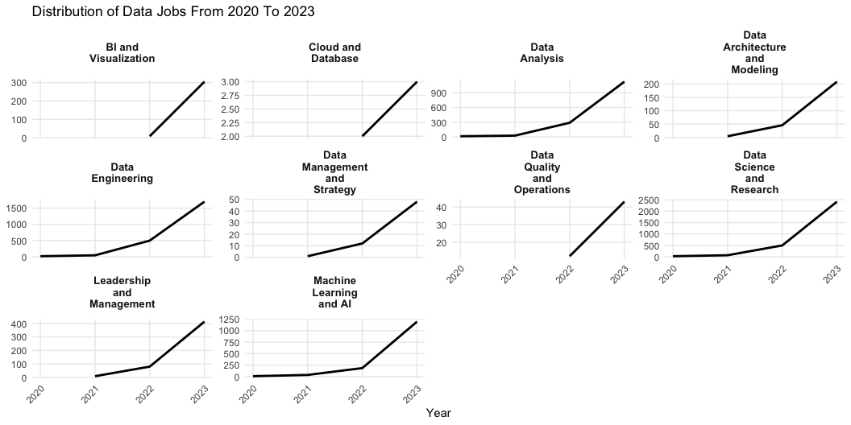
Data Jobs Trends From 2020 to 2023

Slide 5
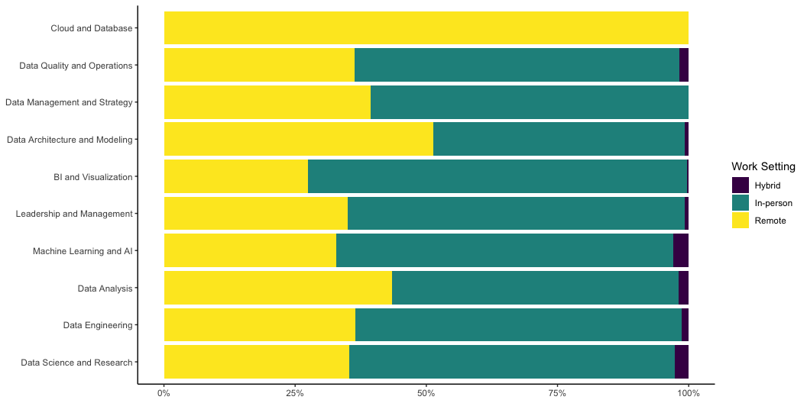
Distribution of Work Settings Amongst Job Categories

Slide 6
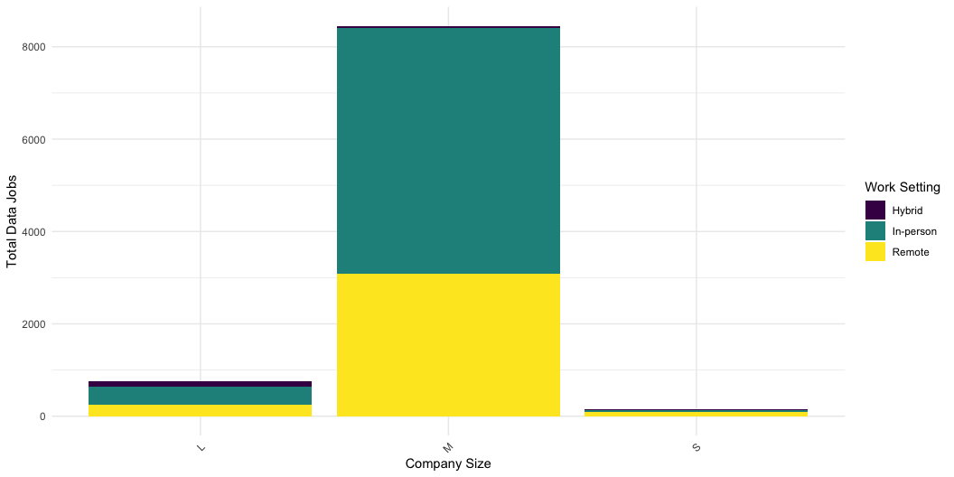
Distribution of Jobs Among Company Sizes by Work Setting

Slide 7
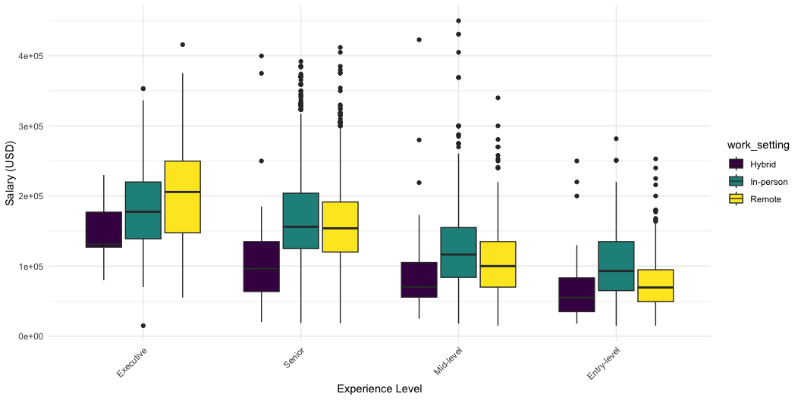
Salary Distribution by Experience level and Work Setting

Slide 8
Proportions of Jobs in Different Countries
Country | Job Count Proportions
 | Job Count | Proportion of Total Jobs
United States | 8132 | 88.48%
United Kingdom | 449 | 4.89%
Canada | 226 | 2.46%
Spain | 113 | 1.23%
Germany | 72 | 0.78%
France | 50 | 0.54%
Australia | 24 | 0.26%
Portugal | 24 | 0.26%
Netherlands | 21 | 0.23%
Brazil | 17 | 0.18%
Colombia | 16 | 0.17%
Greece | 14 | 0.15%
Italy | 13 | 0.14%
Estonia | 10 | 0.11%
Mexico | 10 | 0.11%
Distribution of Jobs Amongst top 15 Company Location

Slide 9
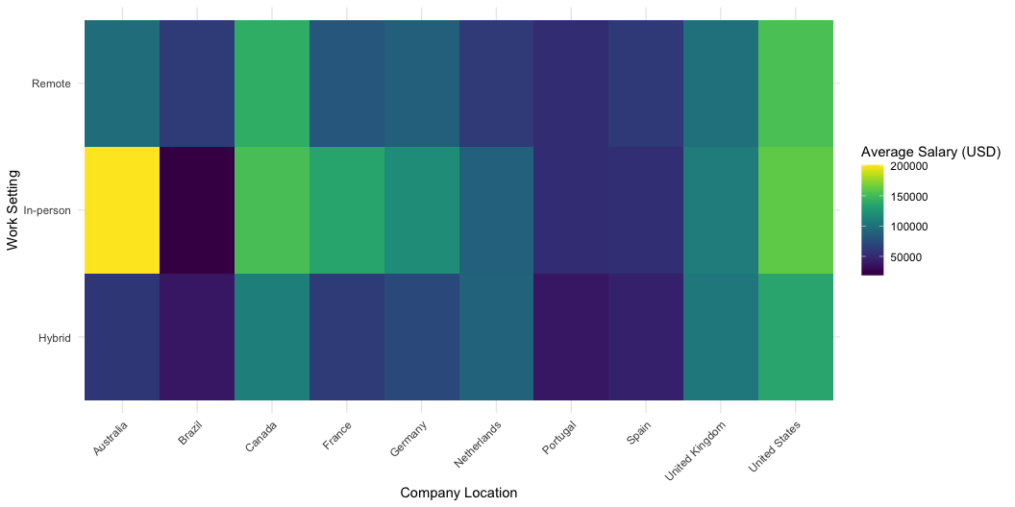
I chose to use company Location as opposed to the employee residence because for employees that work remotely, their residence is not representative of the company location or the country offering the job. Here I chose a cutoff point of 15 since majority of the jobs are concentrated in the top 5 company locations.
Average Salary Heatmap by Company Location and Work Setting

Slide 10
Summary of Productivity Dataset Metrics by Employment Type
Employment_Type | Average Hours Worked | Average Productivity Score | Average Well-Being Score
In-Office | 44.43 | 63.77 | 58.67
Remote | 34.82 | 73.63 | 69.49
Summary of Productivity Dataset

Slide 11
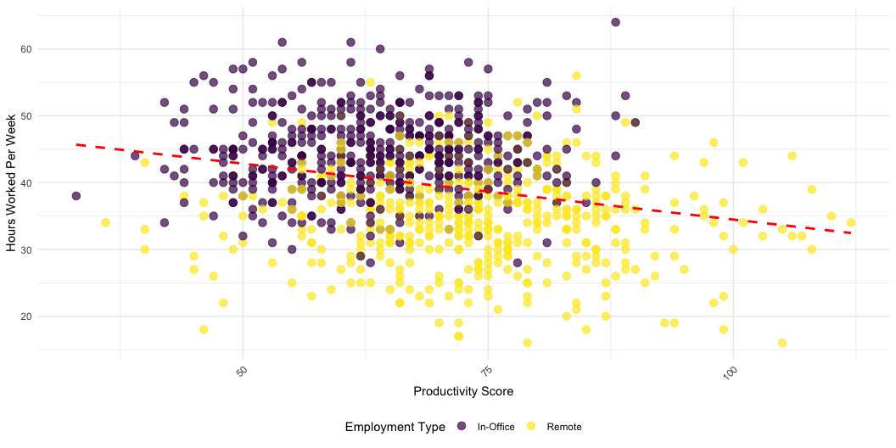
Relationship Between Hours Worked and Productivity

Slide 12
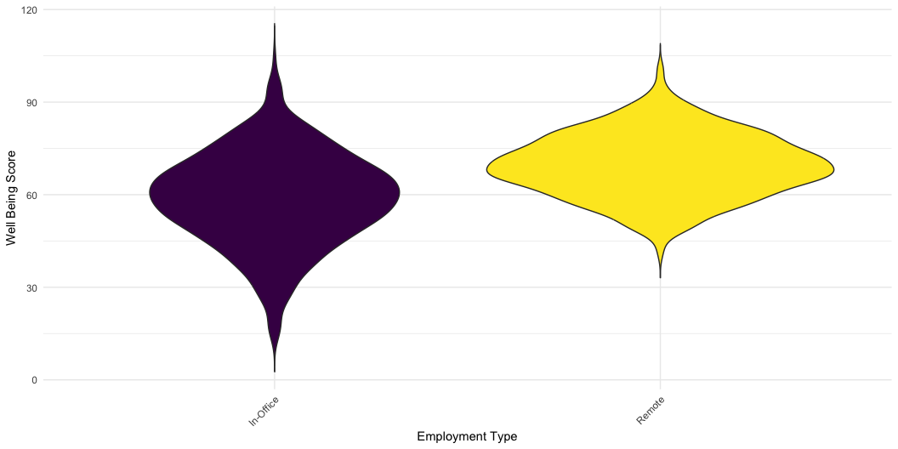
Correlation
Pearson's product-moment correlation data: productivity_data$Productivity_Score and productivity_data$Hours_Worked_Per_Week t = -8.3154, df = 998, p-value = 2.971e-16 alternative hypothesis: true correlation is not equal to 0 95 percent confidence interval: -0.3116245 -0.1956432 sample estimates: cor -0.2545489
We observe a weak negative correlation (r=−0.2545) between the productivity score and hours worked per week. This indicates that as hours worked increase, productivity scores tend to slightly decrease. The correlation is also statistically significant (p<0.001), meaning there is strong evidence in support of the negative relationship and it is unlikely to have occurred by chance.
Well Being Score Distribution by Employment Type

Slide 13
Conclusions
Overview of Data Job Trends
There has been a significant growth in data roles from 2020 to 2023. Diverse job categories with varying opportunities have come up. It is mostly small companies that provide the largest proportion of remote jobs as compared to large companies.
Experiential Factors
There are salary variations based on experience levels, with executives that work remotely earning the most while entry level workers that do hybrid earning the least.
Geographic Insights
There is a predominance of data jobs in the United States, followed by the UK and Canada. The highest paying jobs in the top 10 countries with data jobs are in-person(in-office).
Impact of Work Settings on Productivity
The data and analysis show that longer hours does not necessarily equate to higher productivity, challenging traditional office work assumptions that the big tech executives are pushing to bring back. Even the well-being score of those working remotely is higher than there counterparts that work fully in office.
Closing Remark
In my opinion, big tech CEO’s that claim that the reason for the major layoffs in the past two years is attributed to lower productivity due to remote and hybrid work settings is not entirely true. As we can see from the data, they also spend more on wages and compensation to workers that work from office and therefore their cost cutting agenda is also not justified in this case.
So what is the real reason as to why big tech companies are forcing people back into the office fulltime and also carrying out massive layoffs?

